Slide 1
Internet of Things

Slide 2
Syllabus – Unit 2
Unit No. | Course Content | No. of Hours
2 | Smart Objects: The ―Things in IoT, Sensors, Actuators, and Smart Objects, Sensor Networks, Connecting Smart Objects, Communications Criteria, IoT Access Technologies (IEEE 802.15.4). | 8

Slide 3
Unit 2 Smart Objects: The ―Things in IoT

Slide 4
What is Sensors
Sensors are fundamental building blocks of IoT networks
Sensors are the foundational elements found in smart objects—the “things” in the Internet of Things
Smart objects are any physical objects that contain embedded technology to sense and/or interact with their environment in a meaningful way by being interconnected and enabling communication among themselves or an external agent

Slide 5
Sensors, Actuators and Smart Objects
A sensor: It senses
More specifically, a sensor measures some physical quantity and converts that measurement reading into a digital representation.
That digital representation is typically passed to another device for transformation into useful data that can be consumed by intelligent devices or humans
Sensors are not limited to human-like sensory data.
They are able to provide an extremely wide spectrum of rich and diverse measurement data with far greater precision than human senses

Slide 6
Types of Sensors
Active or passive
How sensors measure
Invasive or non-invasive
Area of Application
Contact or no-contact
Absolute or relative

Slide 7
Types of Sensors
Active or passive
Sensors can be categorized based on whether they produce an energy output and typically require an external power supply (active) or Whether they simply receive energy and typically require no external power supply (passive)
Invasive or non-invasive
Sensors can be categorized based on whether a sensor is part of the environment it is measuring (invasive) or
External to it (non-invasive).

Slide 8
Types of Sensors
Contact or no-contact
Sensors can be categorized based on whether they require physical contact with what they are measuring (contact) or not (no-contact)
Absolute or relative
Sensors can be categorized based on whether they measure on an absolute scale (absolute) or based on a difference with a fixed or variable reference value (relative)

Slide 9
Types of Sensors
Area of application:
Sensors can be categorized based on the specific industry or vertical where they are being used.
How sensors measure
Sensors can be categorized based on the physical mechanism used to measure sensory input (for example, thermoelectric, electrochemical, piezoresistive, optic, electric, fluid mechanic, photoelastic)

Slide 10
Types of Sensors
What sensors measure
Sensors can be categorized based on their applications or what physical variables they measure
Note:
This is by no means an exhaustive list, and there are many other classification and taxonomic schemes for sensors, including those based on material, cost, design, and other factors

Slide 11
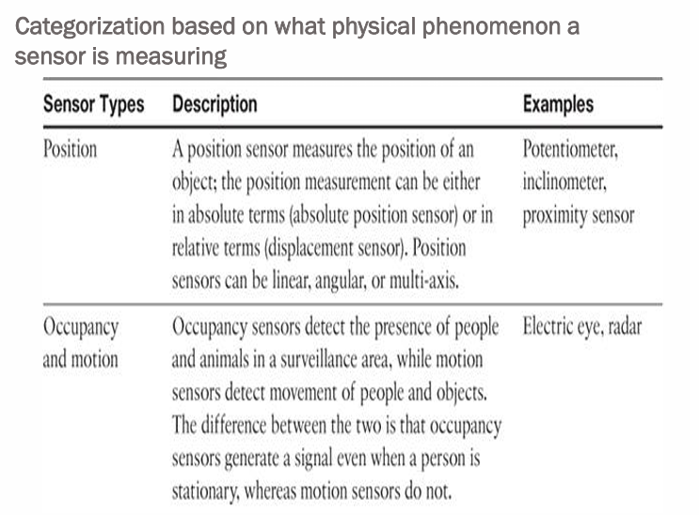

Slide 12
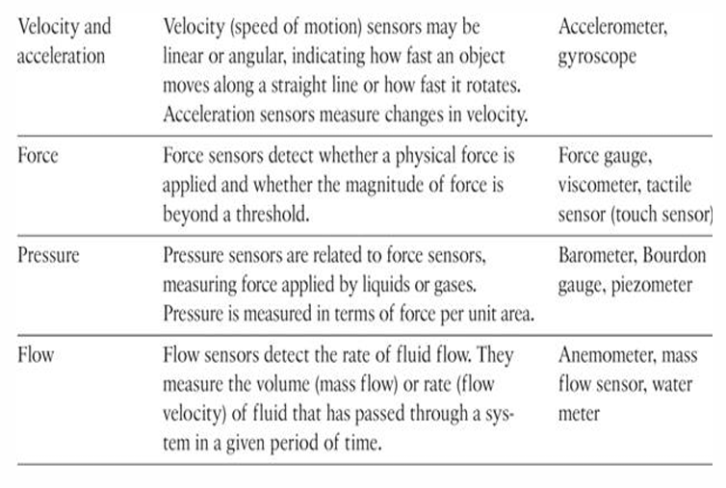

Slide 13
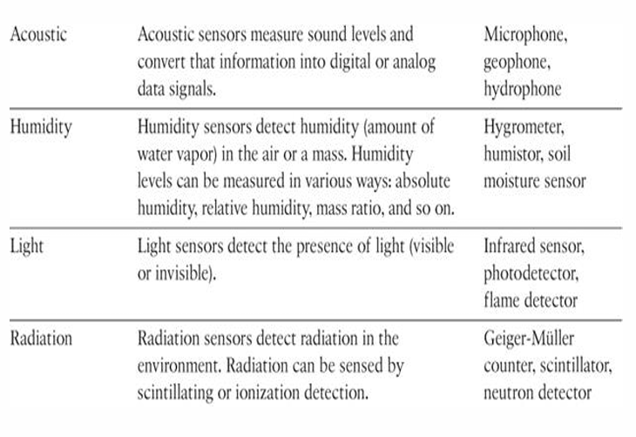

Slide 14
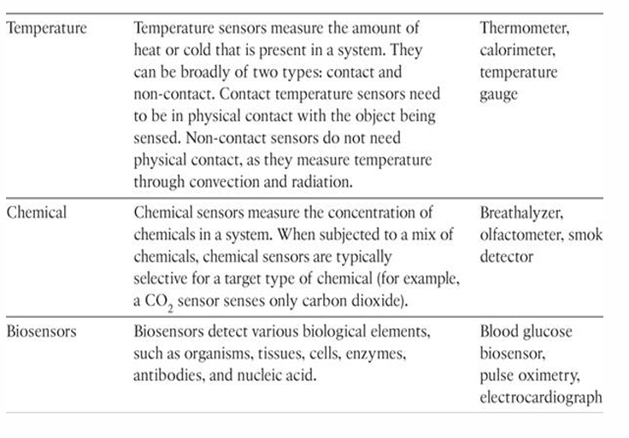

Slide 15
Precision agriculture (smart farming)
which uses a variety of technical advances to improve the efficiency, sustainability, and profitability of traditional farming practices.
This includes the use of GPS and satellite aerial imagery for determining field viability; robots for high-precision planting, harvesting, irrigation, and so on; and real-time analytics and artificial intelligence to predict optimal crop yield, weather impacts, and soil quality.
Among the most significant impacts of precision agriculture are those dealing with sensor measurement of a variety of soil characteristics. These include real- time measurement of soil quality, pH levels, salinity, toxicity levels, moisture levels for irrigation planning, nutrient levels for fertilization planning, and so on.

Slide 16
IoT Use Case: Area of precision agriculture (smart farming)
biodegradable, passive microsensors to measure soil and crop and conditions
These sensors, developed at North Dakota State University (NDSU), can be planted directly in the soil and left in the ground to biodegrade without any harm to soil quality.

Slide 17
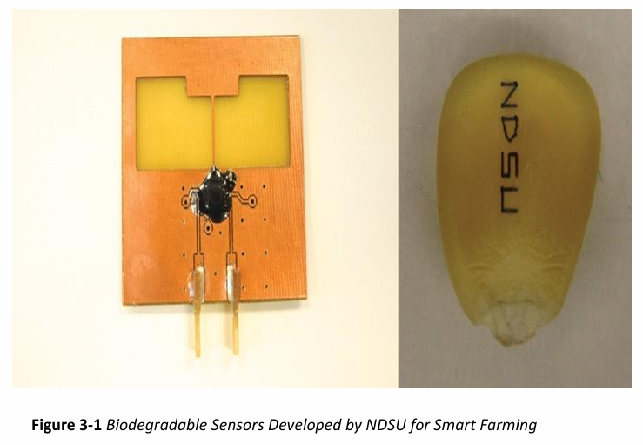

Slide 18
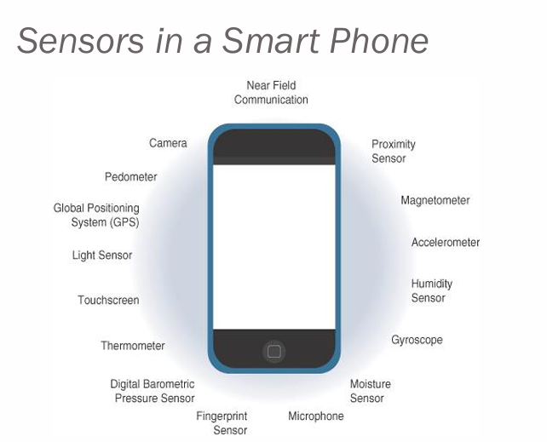

Slide 19
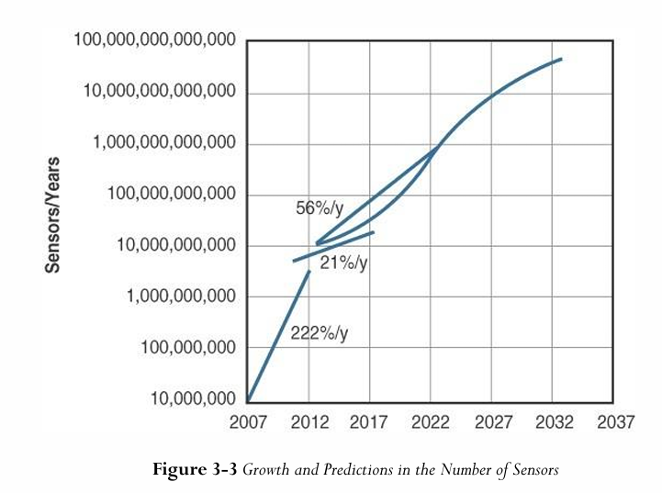

Slide 20
Actuators
Actuators are natural complements to sensors
Sensors are designed to sense and measure practically any measurable variable in the physical world.
They convert their measurements (typically analog) into electric signals or digital representations that can be consumed by an intelligent agent (a device or a human).
Actuators, on the others hand, receive some type of control signal (commonly an electric signal or digital command) that triggers a physical effect, usually some type of motion, force, and so on.

Slide 21
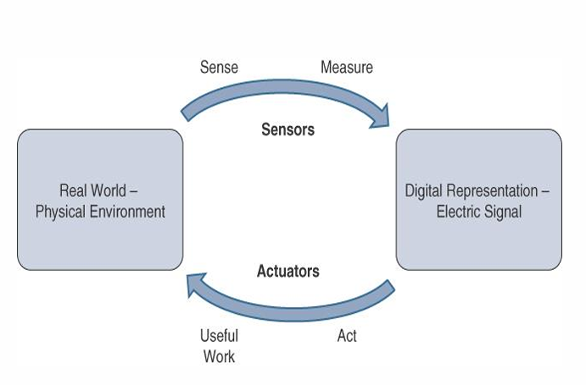

Slide 22
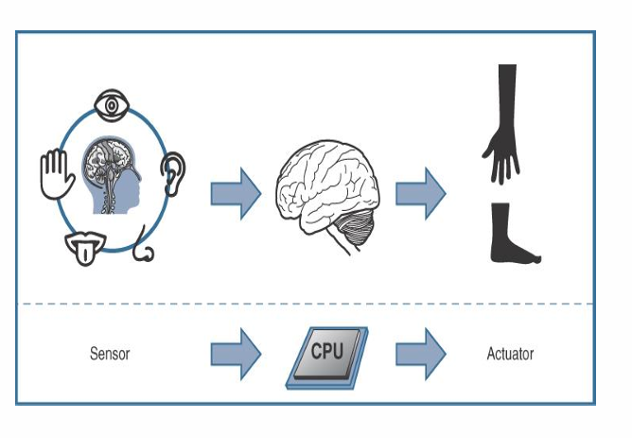

Slide 23
Types of Actuators
Type or motion
Type of energy
power
Area of Application
Binary or continuous

Slide 24
Types of Actuators
Type of motion
Actuators can be classified based on the type of motion they produce (for example, linear, rotary, one/two/three axes)
Power
Actuators can be classified based on their power output (for example, high power, low power, micro power)

Slide 25
Types of Actuators
Binary or continuous:
Actuators can be classified based on the number of stable-state outputs
Area of application:
Actuators can be classified based on the specific industry or vertical where they are used.
Type of energy:
Actuators can be classified based on their energy type.

Slide 26
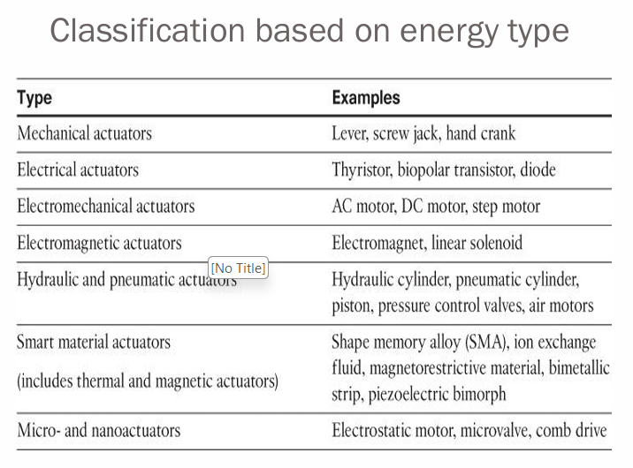

Slide 28
Micro Electro Mechanical System (MEMS)
Interesting advances in sensor and actuator technologies is in how they are packaged and deployed.
Micro-electro-mechanical systems (MEMS), sometimes simply referred to as micro-machines, can integrate and combine electric and mechanical elements, such as sensors and actuators, on a very small (millimeter or less) scale.
One of the keys to this technology is a microfabrication technique that is similar to what is used for microelectronic integrated circuits.

Slide 29
Micro Electro Mechanical System (MEMS)
This approach allows mass production at very low costs
The combination of tiny size, low cost, and the ability to mass produce makes MEMS an attractive option for a huge number of IoT applications.
MEMS devices have already been widely used in a variety of different applications and can be found in very familiar everyday devices.
For example: inkjet printers use micropump MEMS.

Slide 30
Micro Electro Mechanical System (MEMS)
Smart phones also use MEMS technologies for things like accelerometers and gyroscopes.
In fact, automobiles were among the first to commercially introduce MEMS into the mass market, with airbag accelerometers.

Slide 31
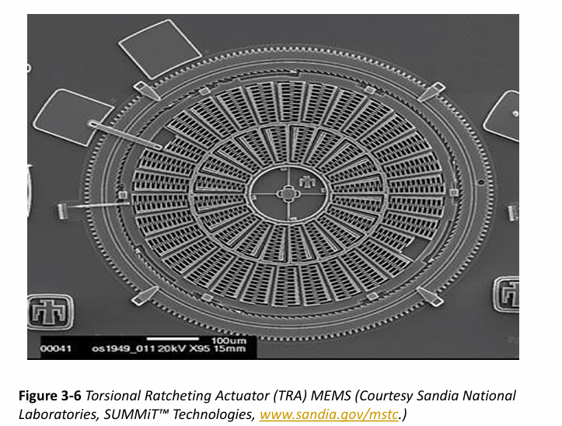

Slide 32
Smart Objects
Smart objects are, quite simply, the building blocks of IoT.
They are what transform everyday objects into a network of intelligent objects that are able to learn from and interact with their environment in a meaningful way
The real power of smart objects in IoT comes from being networked together rather than being isolated as standalone objects
If a sensor is a standalone device that simply measures the humidity of the soil, it is interesting and useful, but it isn’t revolutionary

Slide 33
Smart Objects
If that same sensor is connected as part of an intelligent network that is able to coordinate intelligently with actuators to trigger irrigation systems as needed based on those sensor readings, we have something far more powerful
Extending that even further, imagine that the coordinated sensor/actuator set is intelligently interconnected with other sensor/actuator sets to further coordinate fertilization, pest control, and so on—and even communicate with an intelligent backend to calculate crop yield potential

Slide 34
Smart Objects
A smart object, is a device that has, at a minimum, the following four defining characteristics
Sensor
Actuator
Communication Device
Tiny Low Cost Computer

Slide 35
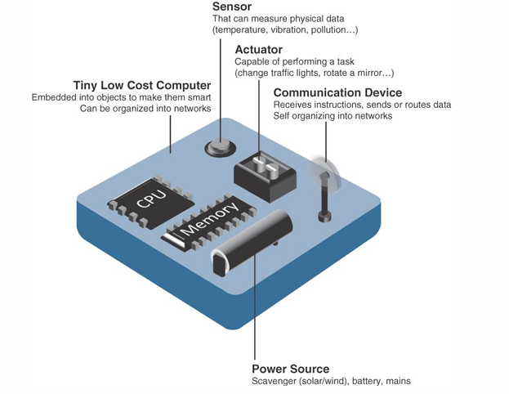

Slide 36
Smart Objects
Processing Unit
Some type of processing unit for
Acquiring data,
Processing and analyzing sensing information received by the sensor(s)
Coordinating control signals to any actuators, and
Controlling a variety of functions on the smart object, including the communication and power systems

Slide 37
Smart Objects
The most common is a microcontroller because of its small form factor, flexibility, programming simplicity, ubiquity, low power consumption, and low cost
Sensors & Actuators
A smart object is capable of interacting with the physical world through sensors and actuators

Slide 38
Trends in Smart Objects
Size is decreasing
Power Consumption is decreasing
Processing power in increasing
Communication capabilities are improving
Communication is being increasingly standardized

Slide 39
Sensor Networks
A sensor/actuator network (SANET), is a network of sensors that sense and measure their environment and/or actuators that act on their environment
The sensors and/or actuators in a SANET are capable of communicating and cooperating
Effective and well-coordinated communication and cooperation is a prominent challenge, primarily because the sensors and actuators in SANETs are diverse, heterogeneous, and resource-constrained.

Slide 40
Sensor Networks
SANETs offer highly coordinated sensing and actuation capabilities.
Smart homes are a type of SANET that display this coordination between distributed sensors and actuators
For example, smart homes can have temperature sensors that are strategically networked with heating, ventilation, and air-conditioning (HVAC) actuators.
When a sensor detects a specified temperature, this can trigger an actuator to take action and heat or cool the home as needed.

Slide 41
Sensor Networks
Advantages and disadvantages that a wireless-based solution offers.
Advantage:
Greater deployment flexibility
Simpler scaling to a large number of nodes
Lower implementation costs
Easier long-term maintenance
Effortless introduction of new sensor/ actuators nodes

Slide 42
Sensor Networks
Advantage:
Better equipped to handle dynamic / rapid topology changes
Disadvantage
Potentially less secure
Lower transmission speeds
Greater level of impact / influence by environment

Slide 43
Wireless Sensor Networks (WSNs)
Wireless sensor networks are made up of wirelessly connected smart objects, which are sometimes referred to as motes.
The fact that there is no infrastructure to consider with WSNs is surely a powerful advantage for flexible deployments, but there are a variety of design constraints to consider with these wirelessly connected smart objects

Slide 44
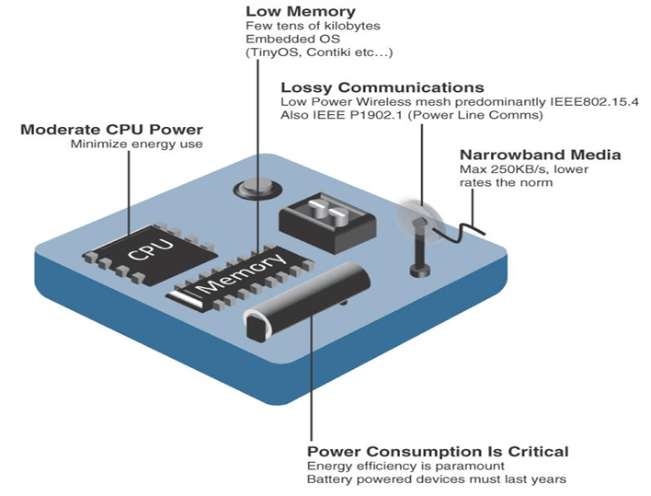

Slide 45
Wireless Sensor Networks (WSNs)
The following are some of the most significant limitations of the smart objects in WSNs
Limited processing power
Limited memory
Lossy communication
Limited transmission speeds
Limited power

Slide 46
Wireless Sensor Networks (WSNs)
These limitations greatly influence how WSNs are designed, deployed, and utilized.
The fact that individual sensor nodes are typically so limited is a reason that they are often deployed in very large numbers.
As the cost of sensor nodes continues to decline, the ability to deploy highly redundant sensors becomes increasingly feasible.
Because many sensors are very inexpensive and correspondingly inaccurate, the ability to deploy smart objects redundantly allows for increased accuracy

Slide 47
Wireless Sensor Networks (WSNs)
Such large numbers of sensors permit the introduction of hierarchies of smart objects.
Such a hierarchy provides, among other organizational advantages, the ability to aggregate similar sensor readings from sensor nodes that are in close proximity to each other

Slide 48
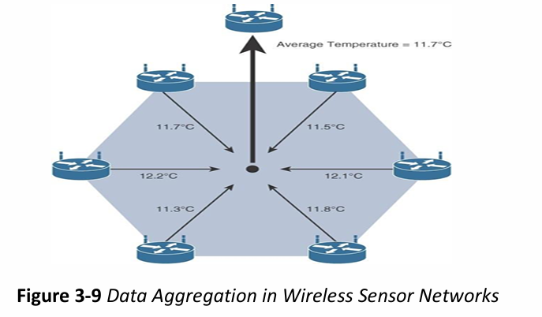
Wireless Sensor Networks (WSNs)
Figure 3-9 shows an example of such a data aggregation function in a WSN where temperature readings from a logical grouping of temperature sensors are aggregated as an average temperature reading

Slide 49
Wireless Sensor Networks (WSNs)
These data aggregation techniques are helpful in reducing the amount of overall traffic (and energy) in WSNs with very large numbers of deployed smart objects.
This data aggregation at the network edges is where fog and mist computing are critical IoT architectural elements needed to deliver the scale and performance required by so many IoT use case

Slide 50
Wireless Sensor Networks (WSNs)
Wirelessly connected smart objects generally have one of the following two communication patterns:
Event-driven:
Transmission of sensory information is triggered only when a smart object detects a particular event or predetermined threshold.
Periodic:
Transmission of sensory information occurs only at periodic intervals.

Slide 51
Wireless Sensor Networks (WSNs)
The decision of which of these communication schemes is used depends greatly on the specific application
For example, in some medical use cases, sensors periodically send postoperative vitals, such as temperature or blood pressure readings. In other medical use cases, the same blood pressure or temperature readings are triggered to be sent only when certain critically low or high readings are measured.

Slide 52
Communication Protocols for Wireless Sensor Networks
There are literally thousands of different types of sensors and actuators.
WSNs are becoming increasingly heterogeneous, with more sophisticated interactions.
Any communication protocol must be able to scale to a large number of nodes.
Likewise, when selecting a communication protocol, you must carefully take into account the requirements of the specific application and consider any trade-offs the communication protocol offers between power consumption, maximum transmission speed, range, tolerance for packet loss, topology optimization, security,and so on

Slide 53
Communication Protocols for Wireless Sensor Networks
They must also enable, as needed, the overlay of autonomous techniques (for example, self-organization, self-healing, self configuration)
Wireless sensor networks interact with their environment. Sensors often produce large amounts of sensing and measurement data that needs to be processed. This data can be processed locally by the nodes of a WSN or across zero or more hierarchical levels in IoT networks
Communication protocols need to facilitate routing and message handling for this data flow between sensor nodes as well as from sensor nodes to optional gateways, edge compute, or centralized cloud compute

Slide 54
Communication Protocols for Wireless Sensor Networks
standardization of communication protocols is a complicated task.
While there isn’t a single protocol solution, there is beginning to be some clear market convergence around several key communication protocols.

Slide 55
Connecting Smart Objects
IoT devices and sensors must be connected to the network for their data to be utilized.
In addition to the wide range of sensors, actuators, and smart objects that make up IoT, there are also a number of different protocols used to connect them

Slide 56
Communication Criteria
The characteristics and attributes you should consider when selecting and dealing with connecting smart objects
Range
Frequency Bands
Power Consumption
Topology
Constrained Devices
Constrained-Node Networks

Slide 57
Communication Criteria
Range
How far does the signal need to be propagated?
That is, what will be the area of coverage for a selected wireless technology?
Should indoor versus outdoor deployments be differentiated?

Slide 58
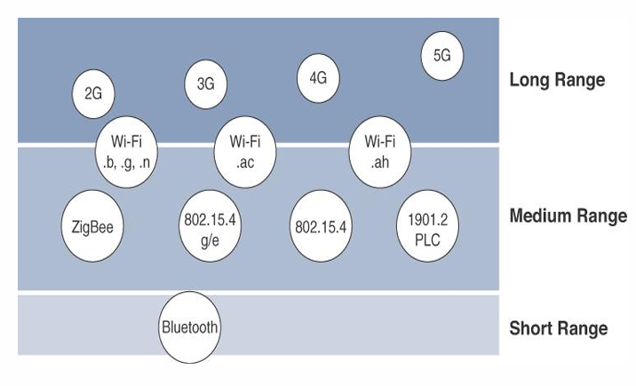

Slide 59
Communication Criteria
Range
Short Range
The classical wired example is a serial cable.
Wireless short-range technologies are often considered as an alternative to a serial cable, supporting tens of meters of maximum distance between two devices.
Examples of short-range wireless technologies are IEEE 802.15.1 Bluetooth and IEEE 802.15.7 Visible Light Communications (VLC)

Slide 60
Communication Criteria
Range
Medium Range
This range is the main category of IoT access technologies.
In the range of tens to hundreds of meters, many specifications and implementations are available.
The maximum distance is generally less than 1 mile between two devices

Slide 61
Communication Criteria
Range
Medium Range
Examples of medium-range wireless technologies include IEEE 802.11 Wi-Fi, IEEE 802.15.4, and 802.15.4g WPAN. .
Wired technologies such as IEEE 802.3 Ethernet and IEEE 1901.2 Narrowband Power Line Communications (PLC)

Slide 62
Communication Criteria
Range
Long Range
Distances greater than 1 mile between two devices require long-range technologies.
Wireless examples are cellular (2G, 3G, 4G) and some applications of outdoor IEEE 802.11 Wi-Fi and Low-Power Wide-Area (LPWA) technologies.
LPWA communications have the ability to communicate over a large area without consuming much power. These technologies are therefore ideal for battery-powered IoT sensors

Slide 63
Communication Criteria
Frequency Bands
Radio spectrum is regulated by countries and/or organizations, such as the International Telecommunication Union (ITU) and the Federal Communications Commission (FCC).
These groups define the regulations and transmission requirements for various frequency bands
For example, portions of the spectrum are allocated to types of telecommunications such as radio, television, military, and so on.

Slide 64
Communication Criteria
Frequency Bands
Focusing on IoT access technologies, the frequency bands leveraged by wireless communications are split between licensed and unlicensed bands.
Licensed spectrum is generally applicable to IoT long range access technologies
In order to utilize licensed spectrum, users must subscribe to services when connecting their IoT devices

Slide 65
Communication Criteria
Frequency Bands
In exchange for the subscription fee, the network operator can guarantee the exclusivity of the frequency usage over the target area and can therefore sell a better guarantee of service.
The ITU has also defined unlicensed spectrum for the industrial, scientific, and medical (ISM) portions of the radio bands.
These frequencies are used in many communications technologies for short-range devices (SRDs).

Slide 66
Communication Criteria
Frequency Bands
Unlicensed means that no guarantees or protections are offered in the ISM bands for device communications
ISM bands for IoT access
2.4 GHz band as used by IEEE 802.11b/g/n Wi-Fi
IEEE 802.15.1 Bluetooth
IEEE 802.15.4 WPAN

Slide 67
Communication Criteria
Power Consumption
Powered nodes and battery-powered nodes
A powered node has a direct connection to a power source, and communications are usually not limited by power consumption criteria.
However, ease of deployment of powered nodes is limited by the availability of a power source, which makes mobility more complex

Slide 68
Communication Criteria
Power Consumption
Battery-powered nodes bring much more flexibility to IoT devices.
These nodes are often classified by the required lifetimes of their batteries.
For battery-powered nodes, IoT wireless access technologies must address the needs of low power consumption and connectivity

Slide 69
Communication Criteria
Power Consumption
A new wireless environment known as Low-Power Wide Area (LPWA)
Battery-powered nodes are often placed in a “sleep mode” to preserve battery life when not transmitting
Wired IoT access technologies consisting of powered nodes are not exempt from power optimization

Slide 70
Communication Criteria
Topology
Among the access technologies available for connecting IoT devices, three main topology schemes are dominant: star, mesh, and peer-to-peer
For long-range and short-range technologies, a star topology is prevalent
Star topologies utilize a single central base station or controller to allow communications with endpoints

Slide 71
Communication Criteria
Topology
For medium-range technologies, a star, peer-to-peer, or mesh topology is common
Peer-to-peer topologies allow any device to communicate with any other device as long as they are in range of each other

Slide 72
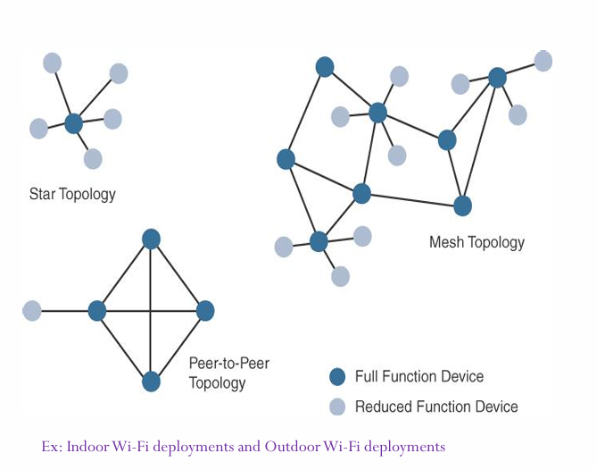

Slide 73
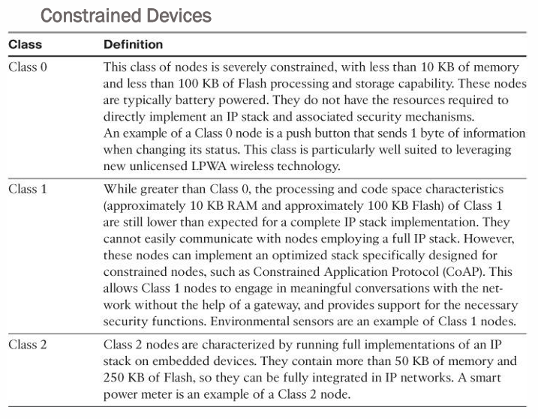

Slide 74
Communication Criteria
Constrained Node Networks
IEEE 802.15.4 and 802.15.4g RF, IEEE 1901.2a PLC, LPWA, and IEEE 802.11ah access technologies
Constrained-node networks are often referred to as low-power and lossy networks (LLNs).
Low power – battery powered constraints

Slide 75
Communication Criteria
Constrained Node Networks
Lossy network -- network performance may suffer from interference and variability due to harsh radio environments
Protocols that can be used for constrained-node networks must be evaluated in the context of the following characteristics: data rate and throughput, latency and determinism, and overhead and payload.

Slide 76
Communication Criteria
Data Rate and Throughput
The data rates available from IoT access technologies range from 100 bps with protocols such as Sigfox to tens of megabits per second with technologies such as LTE and IEEE 802.11ac
However, the actual throughput is less

Slide 77
Communication Criteria
Data Rate and Throughput
The data rates available from IoT access technologies range from 100 bps with protocols such as Sigfox to tens of megabits per second with technologies such as LTE and IEEE 802.11ac
However, the actual throughput is less

Slide 78
Communication Criteria
Data Rate and Throughput
Therefore, understanding the bandwidth requirements of a particular technology, its applicability to given use cases, the capacity planning rules, and the expected real throughput are important for proper network design and successful production deployment
Technologies not particularly designed for IoT, such as cellular and Wi-Fi, match up well to IoT applications with high bandwidth requirements

Slide 79
Communication Criteria
Latency and Determinism
Latency expectations of IoT applications should be known when selecting an access technology
This is particularly true for wireless networks, where packet loss and retransmissions due to interference, collisions, and noise are normal behaviors
On constrained networks, latency may range from a few milliseconds to seconds, and applications and protocol stacks must cope with these wide-ranging values

Slide 80
Communication Criteria
Overhead and Payload
When considering constrained access network technologies, it is important to review the MAC payload size characteristics required by applications
The minimum IPv6 MTU size is expected to be 1280 bytes.
Therefore, the fragmentation of the IPv6 payload has to be taken into account by link layer access protocols with smaller MTUs

Slide 81
Communication Criteria
Overhead and Payload
When considering constrained access network technologies, it is important to review the MAC payload size characteristics required by applications
The minimum IPv6 MTU size is expected to be 1280 bytes.
Therefore, the fragmentation of the IPv6 payload has to be taken into account by link layer access protocols with smaller MTUs

Slide 82
IoT Access Technologies
IEEE 802.15.4
IEEE 802.15.4g and 802.15.4e
IEEE 1901.2a
IEEE 802.11ah
LoRa WAN
NB-IoT and other LTE Variations

Slide 83
IoT Access Technologies
The following topics are addressed for each IoT access technology:
Standardization and alliances:
The standards bodies that maintain the protocols for a technology
Physical layer:
The wired or wireless methods and relevant frequencies
MAC layer:
Considerations at the Media Access Control (MAC) layer, which bridges the physical layer with data link control

Slide 84
IoT Access Technologies
The following topics are addressed for each IoT access technology:
Topology:
The topologies supported by the technology
Security:
Security aspects of the technology
Competitive technologies:
Other technologies that are similar and may be suitable alternatives to the given technology

Slide 85
IoT Access Technologies
IEEE 802.15.4
Wireless access technology for low-cost and low-data-rate devices that are powered or run on batteries
This access technology enables easy installation while remaining both simple and flexible
IEEE 802.15.4 is commonly found in the following types of deployments:
Home and building automation
Automotive networks
Industrial wireless sensor networks
Interactive toys and remote controls

Slide 86
IoT Access Technologies
IEEE 802.15.4
Drawbacks of this includes MAC reliability, unbounded latency, and susceptibility to interference and multipath fading
The negatives around reliability and latency often have to do with the Collision Sense Multiple Access/Collision Avoidance (CSMA/CA) algorithm.
CSMA/CA is an access method in which a device “listens” to make sure no other devices are transmitting before starting its own transmission.

Slide 87
IoT Access Technologies
IEEE 802.15.4
If another device is transmitting, a wait time (which is usually random) occurs before “listening” occurs again
Interference and multipath fading occur with IEEE 802.15.4 because it lacks a frequency-hopping technique

Slide 88
IoT Access Technologies
IEEE 802.15.4
Standardization and Alliances
IEEE 802.15.4 or IEEE 802.15 Task Group 4 defines low data-rate PHY and MAC layer specifications for wireless personal area networks (WPAN).
This is a well-known solution for low complexity wireless devices with low data rates that need many months or even years of battery life.
IEEE 802.15.4-2003 , 802.15.4-2006 , 802.15.4-2011 and 802.15.4-2015

Slide 89
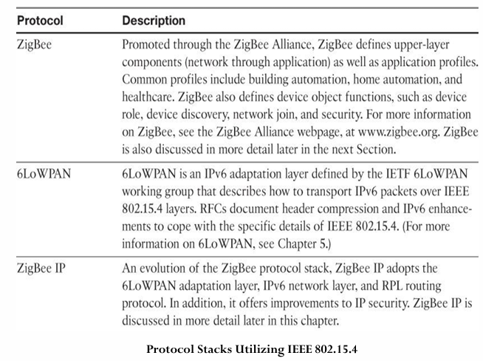

Slide 90
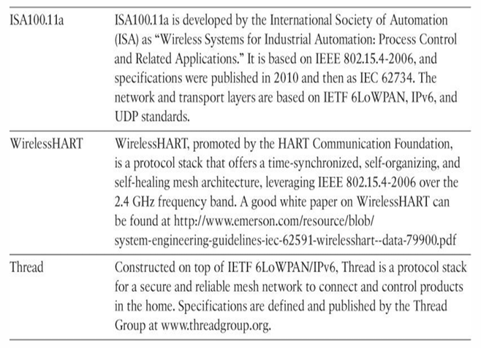

Slide 91
IoT Access Technologies
IEEE 802.15.4
Standardization and Alliances
ZigBee
ZigBee solutions are aimed at smart objects and sensors that have low bandwidth and low power needs.
Furthermore, products that are ZigBee compliant and certified by the ZigBee Alliance should interoperate even though different vendors may manufacture them

Slide 92
IoT Access Technologies
IEEE 802.15.4
Standardization and Alliances
ZigBee
The Zigbee specification has undergone several revisions.
In the 2006 revision, sets of commands and message types were introduced, and increased in number in the 2007 (called Zigbee pro) iteration, to achieve different functions for a device, such as metering, temperature, or lighting control

Slide 93
IoT Access Technologies
IEEE 802.15.4
Standardization and Alliances
ZigBee
The main areas where ZigBee is the most well-known include automation for commercial, retail, and home applications and smart energy
In the industrial and commercial automation space, ZigBee based devices can handle various functions, from measuring temperature and humidity to tracking assets.

Slide 94
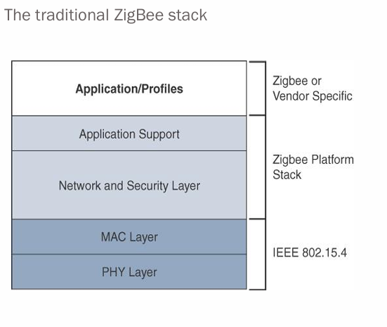

Slide 95
IoT Access Technologies
IEEE 802.15.4
Standardization and Alliances
ZigBee
The ZigBee network and security layer provides mechanisms for network startup, configuration, routing, and securing communications.
This includes calculating routing paths in what is often a changing topology, discovering neighbors, and managing the routing tables as devices join for the first time.

Slide 96
IoT Access Technologies
IEEE 802.15.4
Standardization and Alliances
ZigBee IP
With the introduction of ZigBee IP, the support of IEEE 802.15.4 continues, but the IP and TCP/UDP protocols and various other open standards are now supported at the network and transport layers.
The ZigBee-specific layers are now found only at the top of the protocol stack for the applications

Slide 97
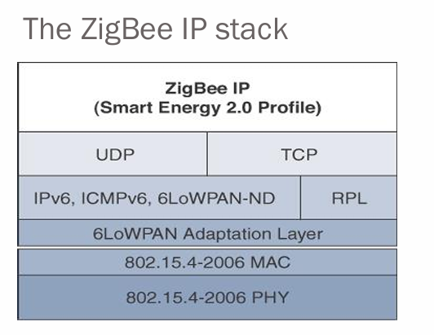

Slide 98
IoT Access Technologies
IEEE 802.15.4
Physical Layer
The 802.15.4 standard supports an extensive number of PHY options that range from 2.4 GHz to sub-GHz frequencies in ISM bands
The original IEEE 802.15.4-2003 standard specified only three PHY options based on direct sequence spread spectrum (DSSS) modulation.

Slide 99
IoT Access Technologies
IEEE 802.15.4
Physical Layer
DSSS (Direct Sequence Spread Spectrum) is a modulation technique in which a signal is intentionally spread in the frequency domain, resulting in greater bandwidth.
The original physical layer transmission options were as follows:
2.4 GHz, 16 channels, with a data rate of 250 kbps
915 MHz, 10 channels, with a data rate of 40 kbps
868 MHz, 1 channel, with a data rate of 20 kbps

Slide 100
IoT Access Technologies
IEEE 802.15.4
Physical Layer
2.4 GHz band operates worldwide.
The 915 MHz band operates mainly in North and South America, and the 868 MHz frequencies are used in Europe, the Middle East, and Africa.
IEEE 802.15.4-2006, 802.15.4-2011, and IEEE 802.15.4-2015 introduced additional PHY communication

Slide 101
IoT Access Technologies
IEEE 802.15.4
Physical Layer
IEEE 802.15.4-2015 introduced additional PHY communication options, including the following
OQPSK PHY: This is DSSS PHY, employing offset quadrature phase-shift keying (OQPSK) modulation. OQPSK is a modulation technique that uses four unique bit values that are signaled by phase changes. An offset function that is present during phase shifts allows data to be transmitted more reliably

Slide 102
IoT Access Technologies
IEEE 802.15.4
Physical Layer
BPSK PHY: This is DSSS PHY, employing binary phase-shift keying (BPSK) modulation. BPSK specifies two unique phase shifts as its data encoding scheme.
ASK PHY: This is parallel sequence spread spectrum (PSSS) PHY, employing amplitude shift keying (ASK) and BPSK modulation. PSSS is an advanced encoding scheme that offers increased range, throughput, data rates, and signal integrity compared to DSSS. ASK uses amplitude shifts instead of phase shifts to signal different bit values.

Slide 103
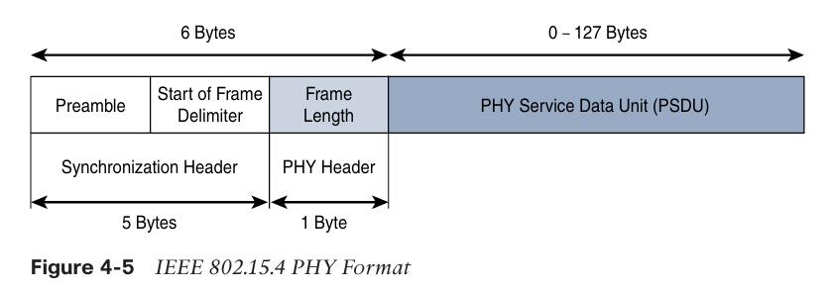

Slide 104
IoT Access Technologies
IEEE 802.15.4
MAC Layer
At this layer, the scheduling and routing of data frames are coordinated
The 802.15.4 MAC layer performs the following tasks:
Network beaconing for devices acting as coordinators (New devices use beacons to join an 802.15.4 network)
PAN association and disassociation by a device
Device Security

Slide 105
IoT Access Technologies
IEEE 802.15.4
MAC Layer
Four types of MAC frames are specified in 802.15.4:
Data frame: Handles all transfers of data
Beacon frame: Used in the transmission of beacons from a PAN coordinator

Slide 106
IoT Access Technologies
IEEE 802.15.4
MAC Layer
Four types of MAC frames are specified in 802.15.4:
Acknowledgement frame: Confirms the successful reception of a frame
MAC command frame: Responsible for control communication between devices

Slide 107
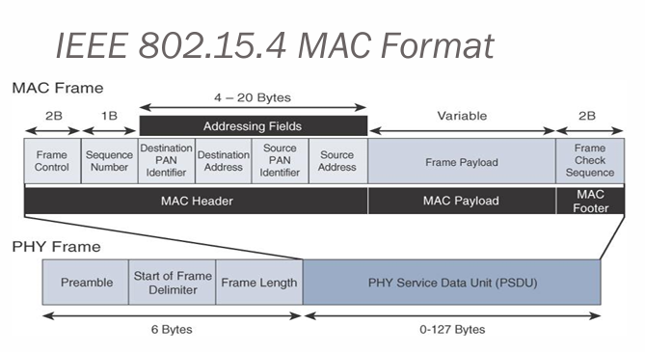

Slide 108
IoT Access Technologies
IEEE 802.15.4
Topology
IEEE 802.15.4–based networks can be built as star, peer-to peer, or mesh topologies.
Mesh networks tie together many nodes.
This allows nodes that would be out of range if trying to communicate directly to leverage intermediary nodes to transfer communications.
Every 802.15.4 PAN should be set up with a unique ID.

Slide 109
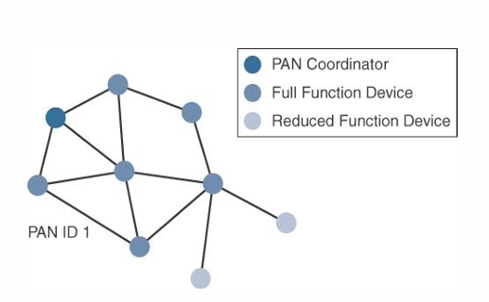

Slide 110
IoT Access Technologies
IEEE 802.15.4
Security
The IEEE 802.15.4 specification uses Advanced Encryption Standard (AES) with a 128-bit key length as the base encryption algorithm for securing its data
AES is a block cipher, which means it operates on fixed-size blocks of data
symmetric key - means that the same key is used for both the encryption and decryption of the data

Slide 111
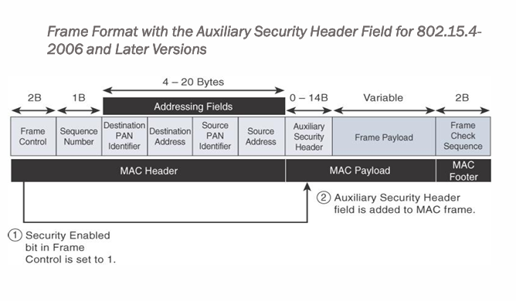

Slide 112
Thank You

